Slide 1
Lit Review Resilient observers via Compressed sensing
Yu Zheng
yz19b@fsu.edu

Slide 2




What is Compressed Sensing (CS)
Nyquist–Shannon sampling theorem：
if a real signal's highest frequency is less than half of the sampling rate, then the signal can be reconstructed perfectly by means of sinc interpolation.
Nose{…, …, …, …}
Eye{…, …, …, …}
body{…, …, …, …}
muscle{…, …, …, …}
……
Hair{…, …, …, …}
Head {…, …, …, …}
body{…, …, …, …}
Definition：
Compressed sensing refers to recover a sparse signal from very few non-adaptive, linear measurements by convex optimization.
Notes:
given knowledge about a signal's sparsity, the signal may be reconstructed with even fewer samples than the sampling theorem requires.

Slide 3
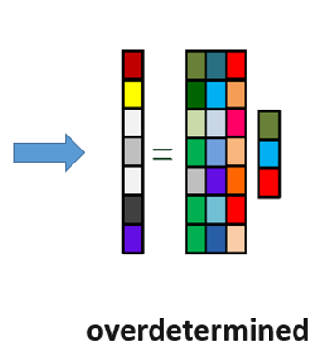
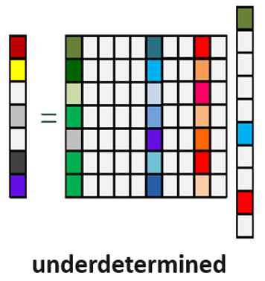

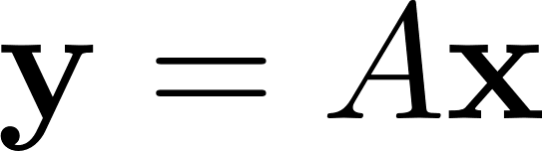
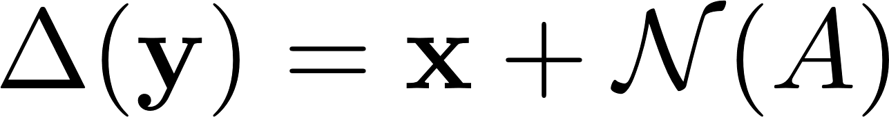
Underdetermined Observation Model
All solutions of recovery:
Notes:
The minimal number of measurements should be 2k, if you want to recover x exactly based on the noiseless model

Slide 4
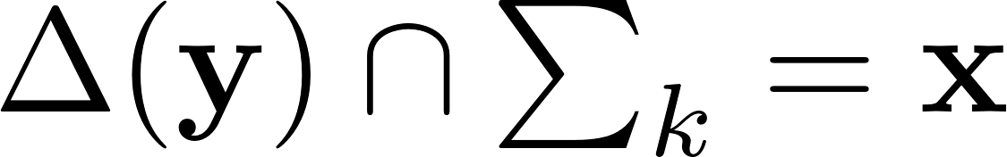
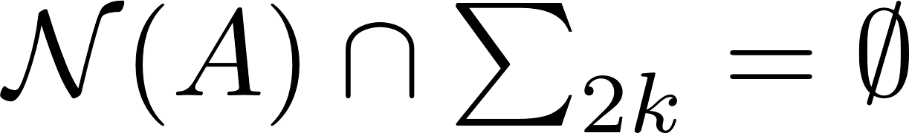
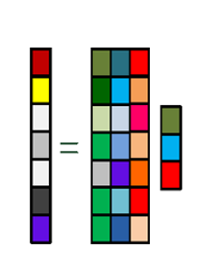
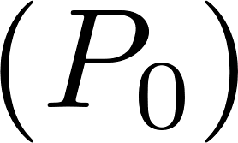
Exact Recovery:
Every set of 2k or fewer columns of A is linearly independent
Q1. What if x is not k-sparse?
Q2. How to solve ?
Notes:
The minimal number of measurements should be 2k, if you want to recover x exactly based on the noiseless model

Slide 5
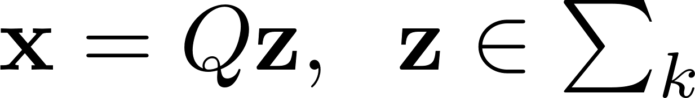
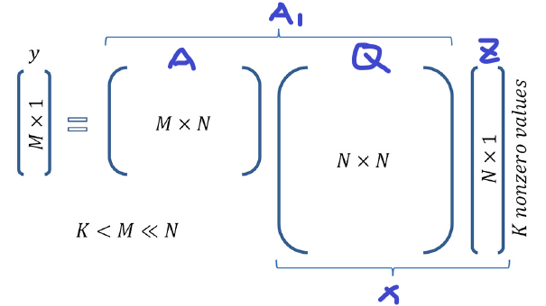
What is Compressed Sensing
If x is not k-sparse:
Find a sparse basis matrix Q satisfying
Best K-sparsity approximation error:
Nearly Exact Recovery
Notes:
Minimal Distance between k-sparse estimation and actual states x
Due to the shape of the 1 ball, 1 minimization indeed promotes sparsity.

Slide 6
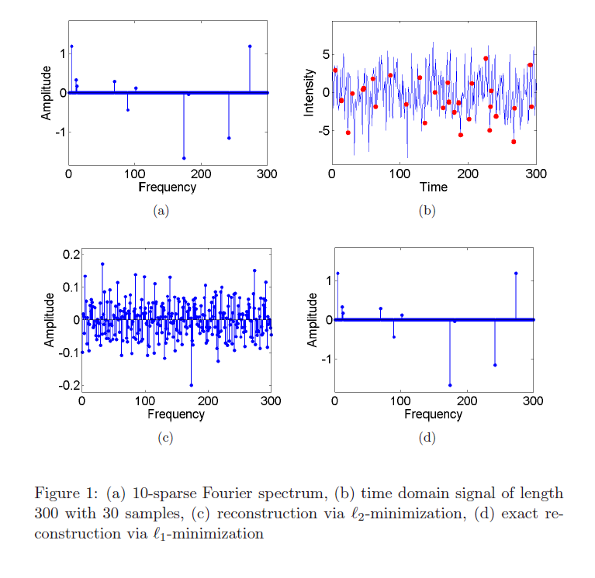
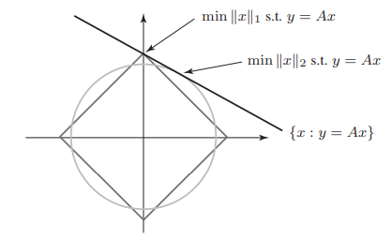
m=1，n=2
Cite: Compressive sensing, Fornasier, Massimo
Notes:
Minimal Distance between k-sparse estimation and actual states x
Due to the shape of the 1 ball, 1 minimization indeed promotes sparsity.

Slide 7

What is Compressed Sensing
Underdetermined Observation Model
Null space property:
Noiseless case:
Exact null space property :
Exact k-sparse recovery:
Stable null space property :
Stable k-sparse recovery:
Notes:
Minimal Distance between k-sparse estimation and actual states x

Slide 8
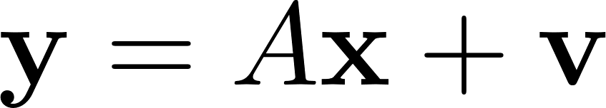
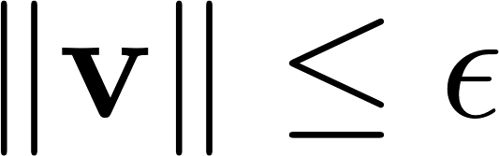

What is Compressed Sensing
Underdetermined Observation Model
Null space property:
Noisy case with bound ( ):
Robust null space property :
Robust k-sparse recovery:
Notes:
Minimal Distance between k-sparse estimation and actual states x

Slide 9
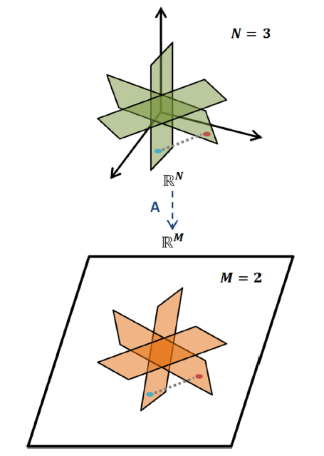
Restricted Isometry Property (RIP):
This property requires every set of S or less columns of A behaves like an orthonormal system approximately
RIP defines the recovery ability of observation matrix
Exact Recovery:
Every set of 2k or fewer columns of A is linearly independent
Notes:
Minimal Distance between k-sparse estimation and actual states x

Slide 10
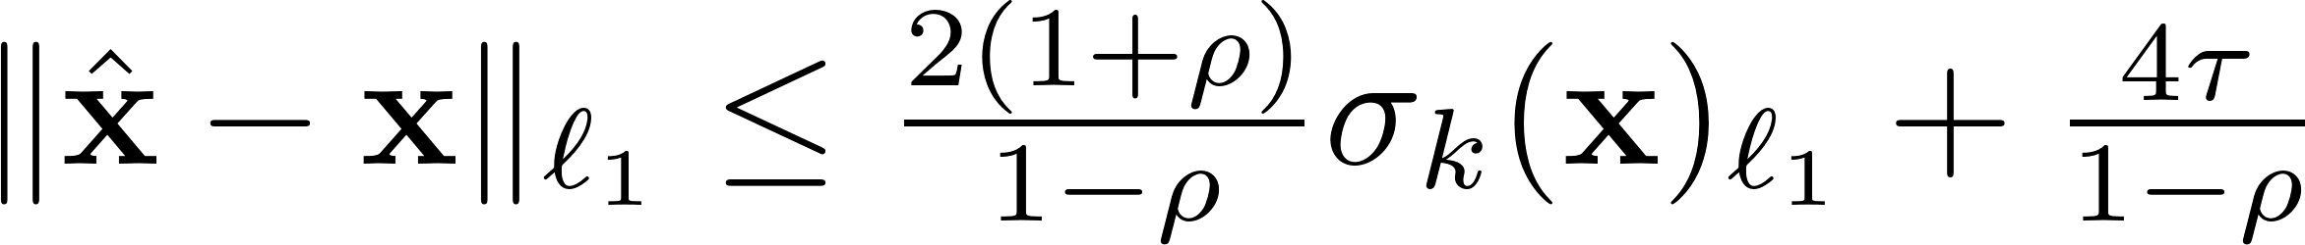
Theorems for sparse recovery based on RIP
Noiseless case:
Exact k-sparse recovery
Noisy case:
L2 norm robust null space property
Robust nearly k-sparse recovery
Notes:
Include the correlation between residual and prediction

Slide 11
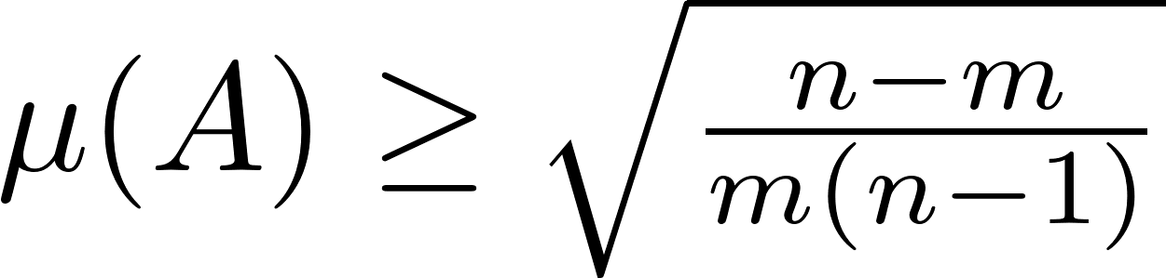
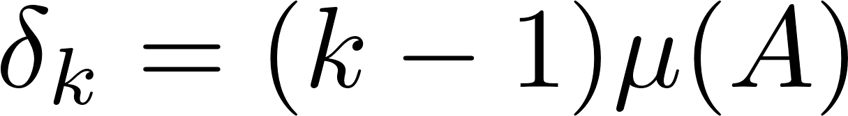
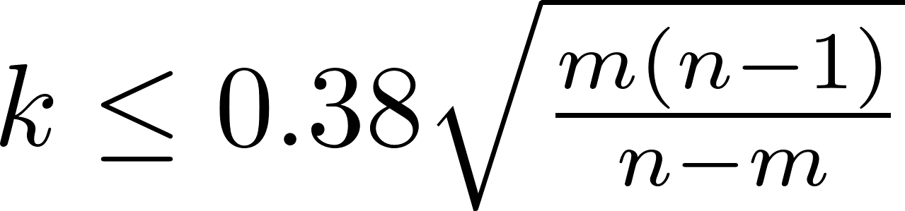
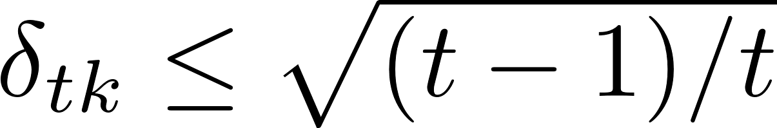
Coherence
a classical way of analyzing the recovery abilities of a measurement matrix.
RIP via Coherence:
1000 dimensional signal x, 500 measurements y,
k<=12
Notes:
a column-normalized matrix A has small coherence if all its columns are nearly orthogonal to each other.
Therefore it is not surprising that there is a relationship between coherence and the RIP.

Slide 12
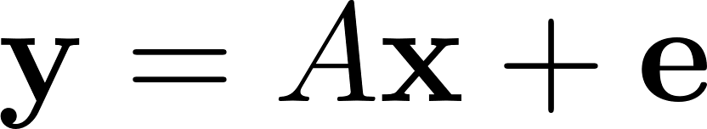

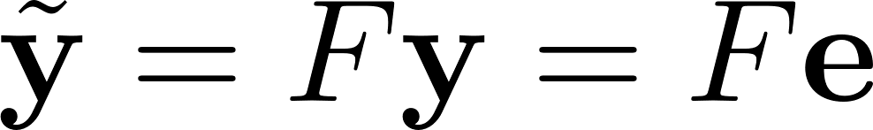
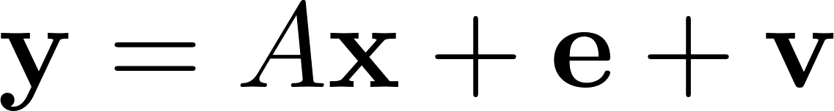
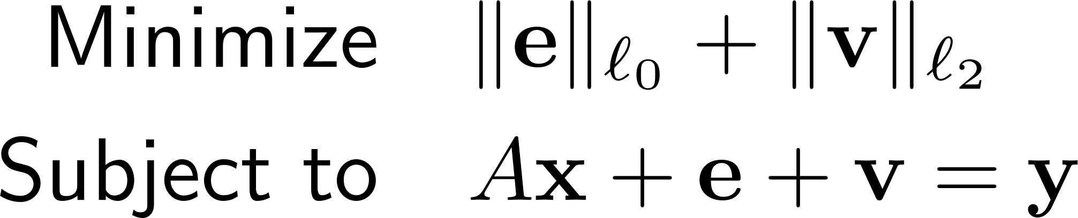
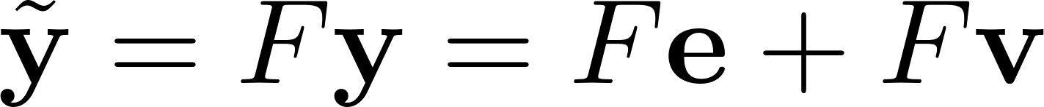
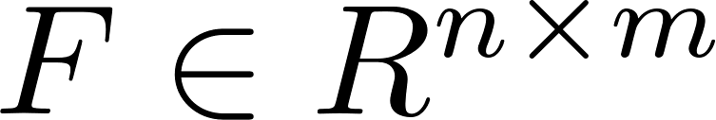
Resilient Estimation
Noiseless case:
Noisy case:
Common assumption:
1. only a small fraction of the entries are attacked
2. exist a coding matrix F with FA=0
(F could be the orthogonal projection onto the cokernel of A)

Slide 13
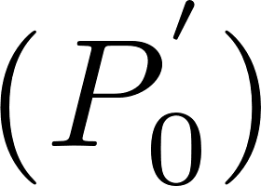
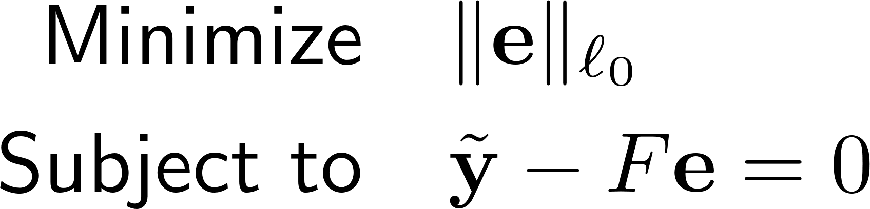
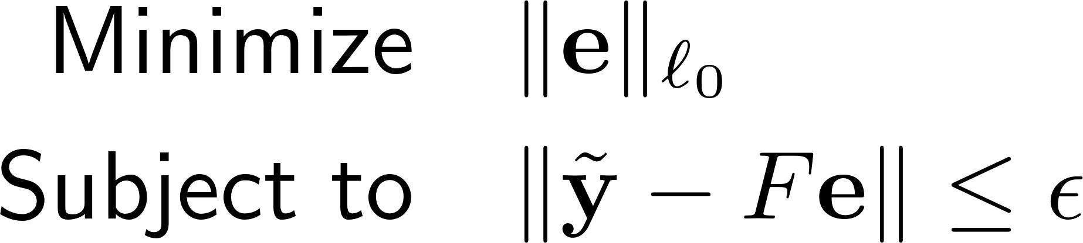

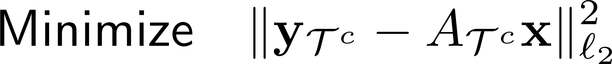
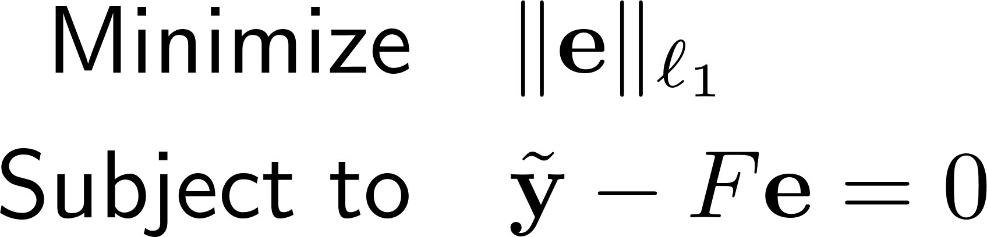
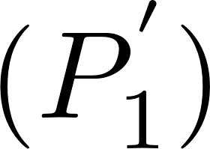
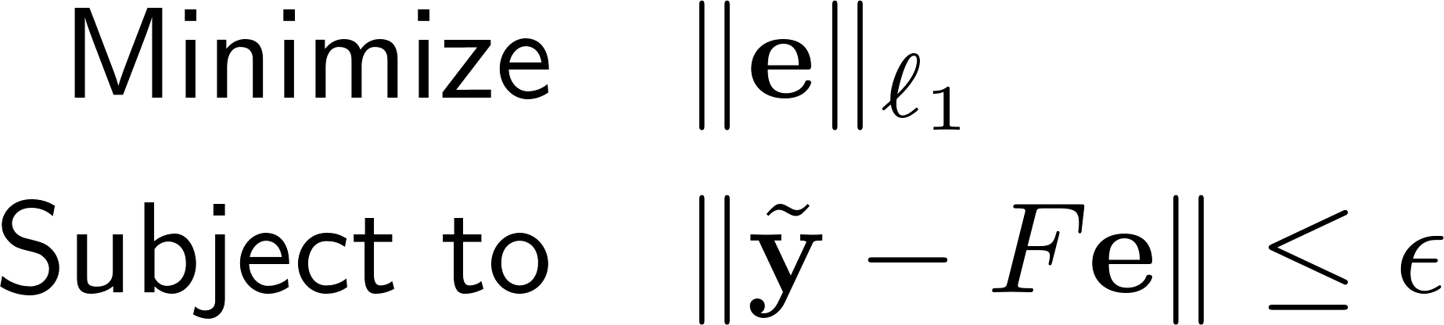
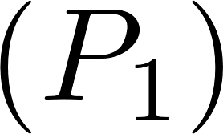
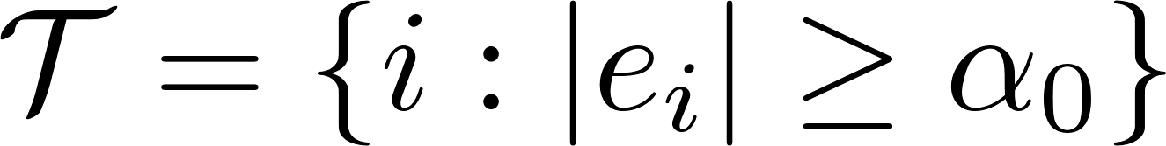
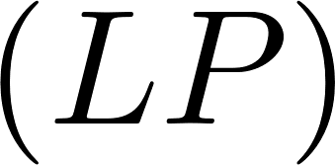

Resilient Estimation via Compressed Sensing
Noiseless case
Noisy Case
S-RIP
S-RIP
Notes:
Minimal Distance between k-sparse estimation and actual states x

Slide 14


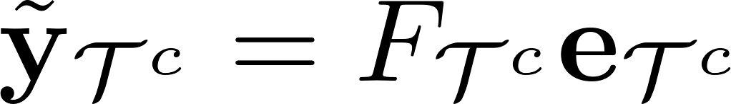
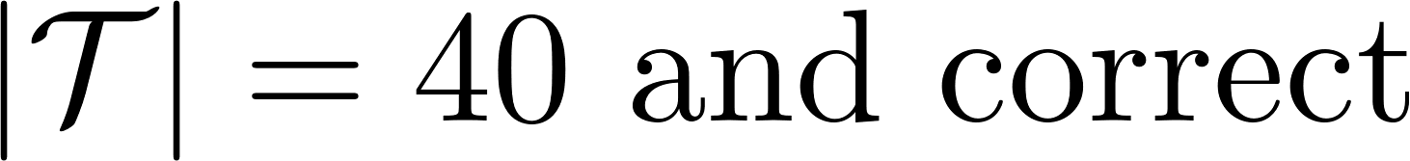

Resilient Estimation via Compressed Sensing
Are compressed sensing’s results enough for resilient estimation?
1000 dimensional signal e, 500 measurements y
k<=12
Oracle
Notes:
Minimal Distance between k-sparse estimation and actual states x

Slide 15
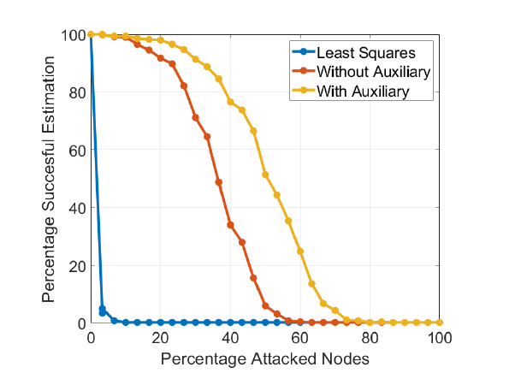
Resilient Estimation via Compressed Sensing
Resilient Optimal Estimation Using Measurement Prior – Dr. Anubi
QR decomposition + probability oracle
Notes:
Minimal Distance between k-sparse estimation and actual states x

Slide 16
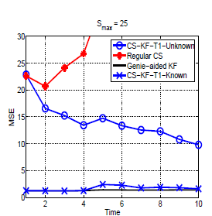
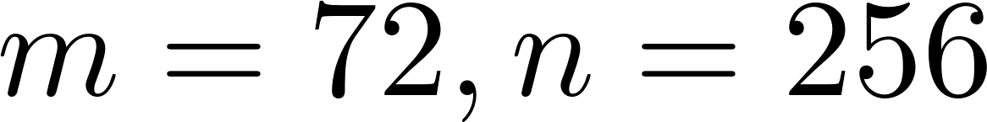
Resilient Estimation via Compressed Sensing
Kalman Filtered Compressed sensing – Dr. Vaswani
Recursive process + Deterministic oracle
Notes:
Minimal Distance between k-sparse estimation and actual states x

Slide 17
Summary for Resilient Estimation
Attack localization algorithm
Oracle
L1-minimization
Support of attacks
Correct the attacked measurements
Robust LSE, MSME
Notes:
Minimal Distance between k-sparse estimation and actual states x

Slide 18
Any Question?
Notes:
Minimal Distance between k-sparse estimation and actual states x

